Slide 1
MULTIPLE BREAK REBAR
Advisor : Prof. K.C.Chang
Presenters : You-Ran Nai

Slide 2
Incremental Dynamic Analysis with Multi-Modes for Seismic Performance Evaluation of RC Bridges
Prakit Chomchuen, Virote Boonyapinyo
Engineering Structures
February 2017
Notes:
標題
作者
期刊名稱
年份

Slide 3
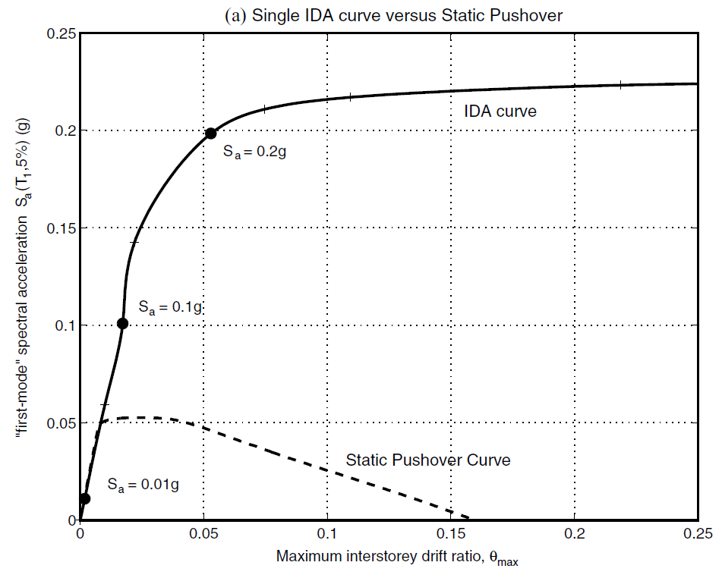
IDA Curve
MDOF
Nonlinear Time History Analyses
Nonlinear Static Analysis
Intensity Measure
MDOF
=>
ESDOF
Damage Measure
Higher Mode
INCREMENTAL DYNAMIC ANALYSIS
Notes:
傳統的

Slide 4
Require Experienced
Modal Pushover Analysis (MPA)
Energy-Based Pushover Analysis (EPA)
Adaptive Pushover Analysis (APA)

Slide 5
Principal Objectives
Three Different Heights
Seismic Performance
Higher Mode
A lateral load pattern that includes higher mode effect for single-run displacement-based NSA to evaluate the lateral behavior of ESDOF.
Applicability of IDA of ESDOF with proposed load pattern in evaluating seismic performance of single column RC with three different column heights.
Evaluate the seismic performance of the typically single-column reinforced concrete bridge used in Thailand.

Slide 6
Outline
1
2
3
4
5
Case study of single-column RC bridge structures
Seismic performance evaluation by incremental dynamic analysis
Nonlinear static analysis of the studied bridges with various load patterns
Incremental dynamic analysis of studied bridges by ESDOF with various load patterns
Performance of the bridges under considered earthquake

Slide 7
Outline
1
2
3
4
5
Case study of single-column RC bridge structures
Seismic performance evaluation by incremental dynamic analysis
Nonlinear static analysis of the studied bridges with various load patterns
Incremental dynamic analysis of studied bridges by ESDOF with various load patterns
Performance of the bridges under considered earthquake

Slide 8
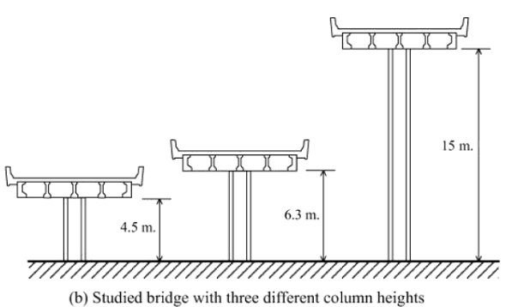
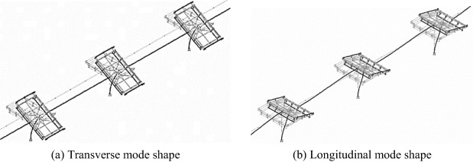
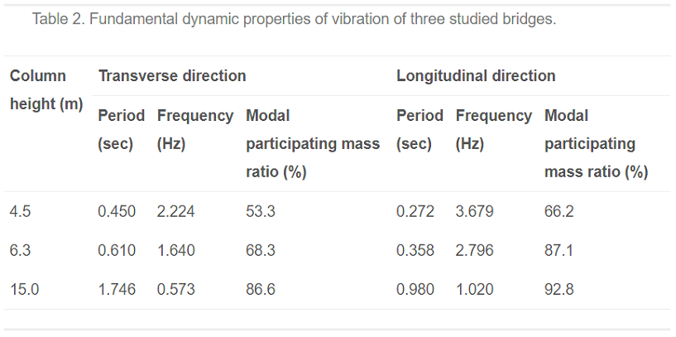
Case study of single-column RC bridge structures

Slide 9
Outline
1
2
3
4
5
Case study of single-column RC bridge structures
Seismic performance evaluation by incremental dynamic analysis
Nonlinear static analysis of the studied bridges with various load patterns
Incremental dynamic analysis of studied bridges by ESDOF with various load patterns
Performance of the bridges under considered earthquake

Slide 10
Seismic performance evaluation by incremental dynamic analysis
seismic demand
applying the capacity (limit state) to demand

Slide 11
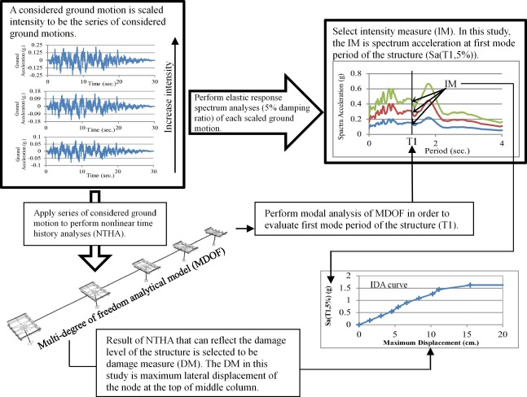
IDA of multi-degree of freedom system

Slide 12
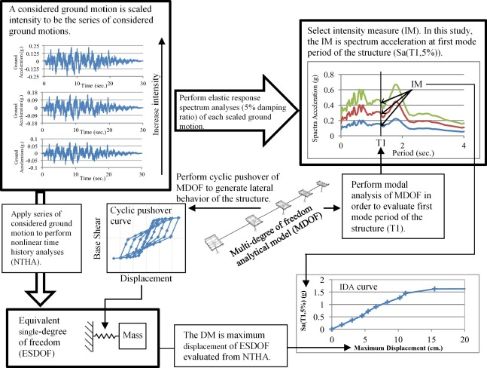
IDA of ESDOF based on nonlinear static analysis

Slide 13
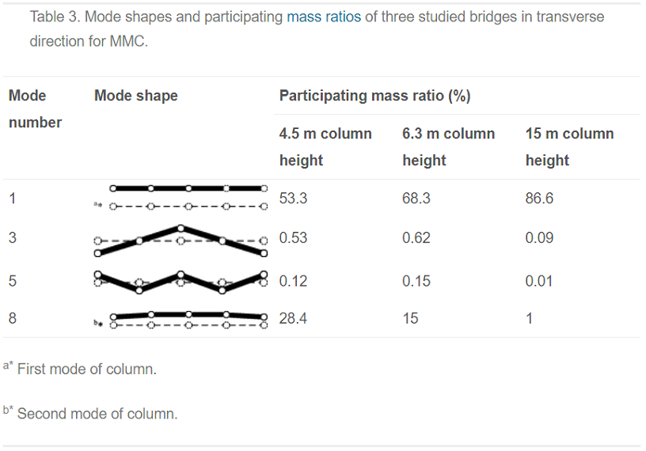
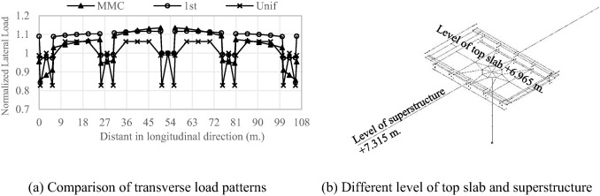
Lateral load pattern for single-run nonlinear static analysis
FEMA 356
First mode load pattern (1st)
Multi-Modes Combination load pattern (MMC)
Uniform acceleration load pattern (Unif)

Slide 14
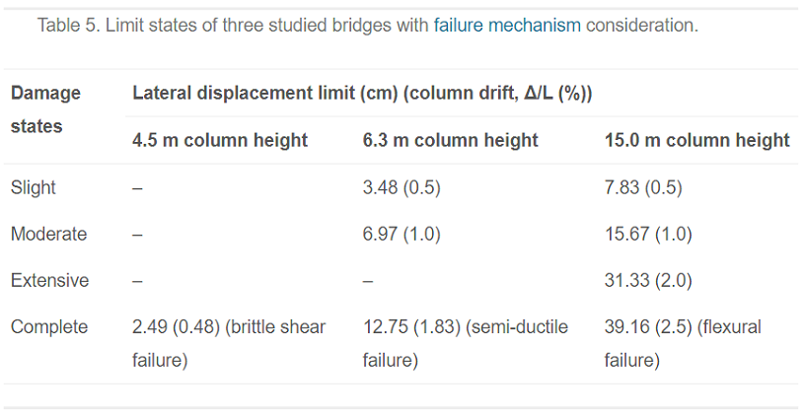
Limit states of the studied bridges

Slide 15
Outline
1
2
3
4
5
Case study of single-column RC bridge structures
Seismic performance evaluation by incremental dynamic analysis
Nonlinear static analysis of the studied bridges with various load patterns
Incremental dynamic analysis of studied bridges by ESDOF with various load patterns
Performance of the bridges under considered earthquake

Slide 16
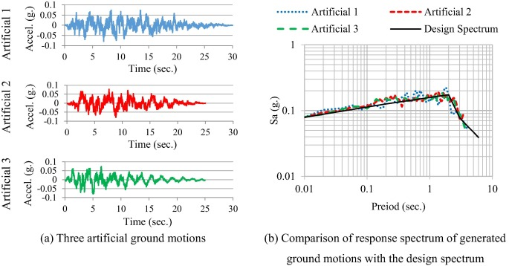

Slide 17
Outline
Introduction
Case study of single-column RC bridge structures
Seismic performance evaluation by incremental dynamic analysis
Artificial ground motions
Nonlinear static analysis of the studied bridges with various load patterns
Incremental dynamic analysis of studied bridges by ESDOF with various load patterns
Performance of the bridges under considered earthquake
Conclusions

Slide 18
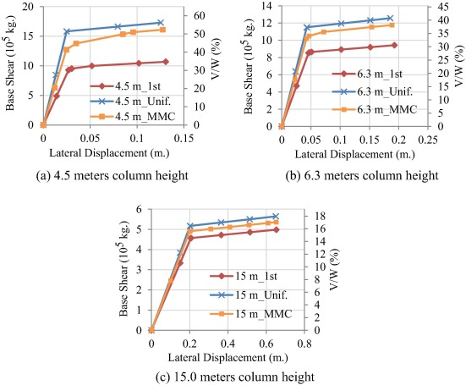

Slide 19
Outline
Introduction
Case study of single-column RC bridge structures
Seismic performance evaluation by incremental dynamic analysis
Artificial ground motions
Nonlinear static analysis of the studied bridges with various load patterns
Incremental dynamic analysis of studied bridges by ESDOF with various load patterns
Performance of the bridges under considered earthquake
Conclusions

Slide 20
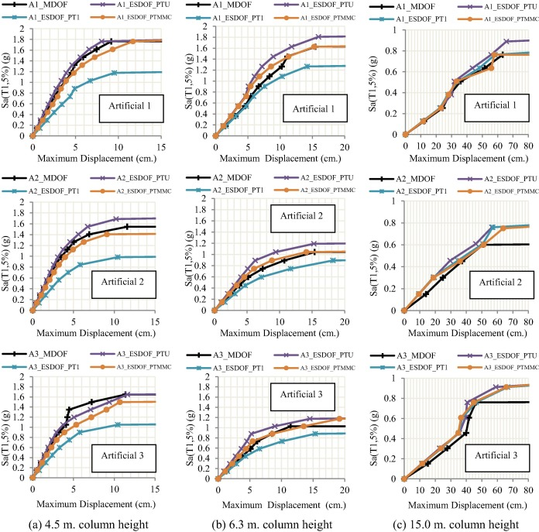

Slide 21
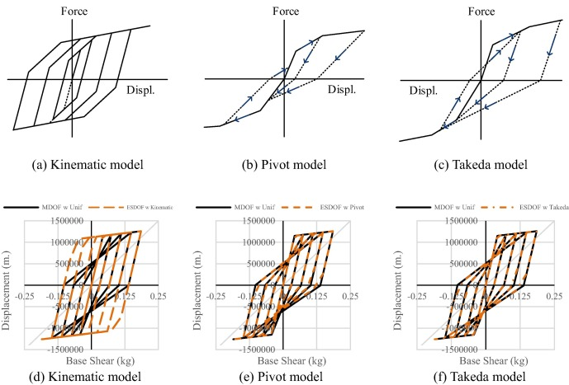

Slide 22
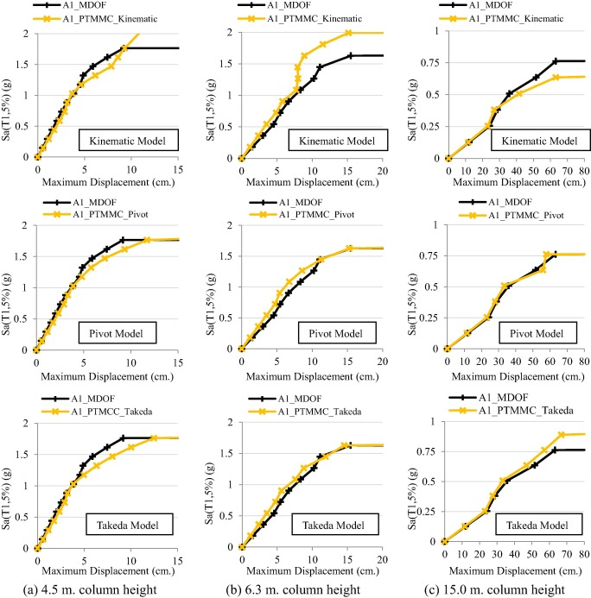

Slide 23
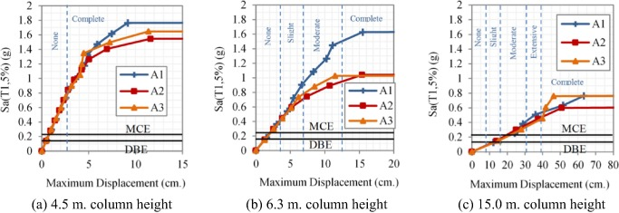

Slide 24
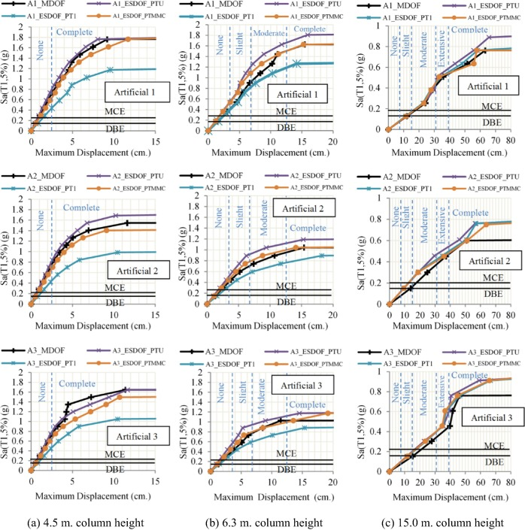

Slide 25
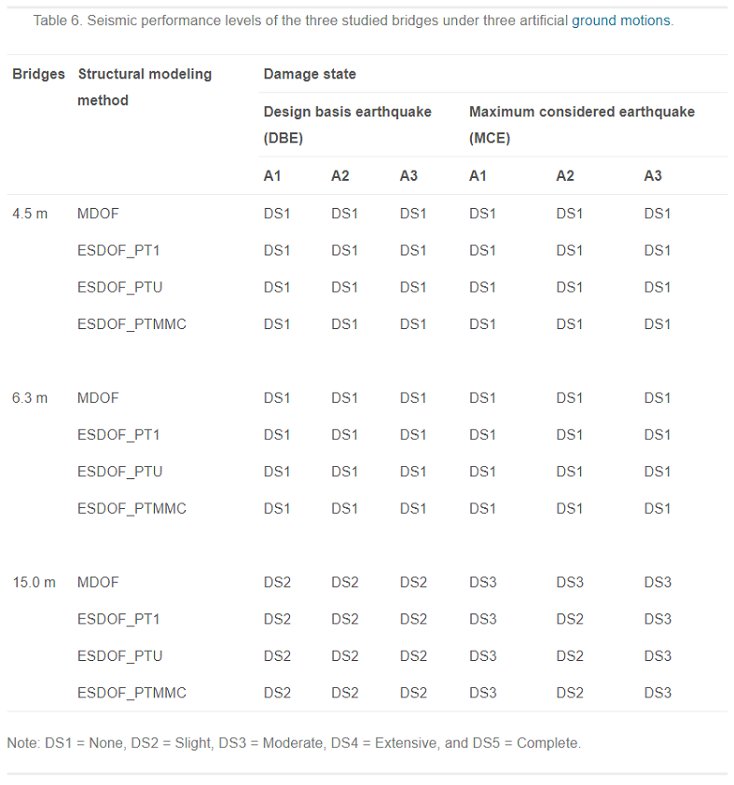

Slide 26
Outline
Introduction
Case study of single-column RC bridge structures
Seismic performance evaluation by incremental dynamic analysis
Artificial ground motions
Nonlinear static analysis of the studied bridges with various load patterns
Incremental dynamic analysis of studied bridges by ESDOF with various load patterns
Performance of the bridges under considered earthquake
Conclusions

Slide 28
學習心得
細節交代得很清楚
前提條件講得很清楚
這是目前讀過講得非常清楚的一篇 paper

Slide 29
Awesome features
Awesome map feature
Awesome like feature
Awesome battery feature

Slide 30
Use case
1
2
3
4
5
Very Easy Step 1
Very Easy Step 2
Very Easy Step 3
Very Easy Step 4
Very Easy Step 5

Slide 31
Value Proposal
Make things really change
Make the world a better place
Offer one perfect answer
This is how we are going to make this happen in a beautiful way.
This is how we are going to make this happen in a beautiful way.
This is how we are going to make this happen in a beautiful way.

Slide 32
Market Sizing
$36b
$12b
$2b
Total World Market
Total US Market
Total FR Market
Source : source.io
Source : source.io
Source : source.io

Slide 33
Market Size over Time
Market Sizing (in €billions)

Slide 34
Market on Map
$1b
$2b

Slide 35
Why Now ?
Mobile Internet Usage

Slide 36


Customer Profiles
Young adults
25-35 years old
Students
15-20 years old

Slide 37
Competitors

Slide 38
AXIS 2
Your company
competitor
competitor
AXIS 1
AXIS 1
competitor
competitor
competitor
competitor
AXIS 2

Slide 39
 | YOUR COMPANY | COMPETITOR 1 | COMPETITOR 2 | COMPETITOR 3
feature 1
feature 2
feature 3
feature 4
feature 5
feature 6

Slide 40
Metrics
800
97%
94%
Paying users
Margin
Recurring users
$150,000
85,000
54
Monthly Recurring
Revenue
Users growing 45% per month
API Integrations

Slide 41
Conversion Rate
0,27%

Slide 42
Split Budget

Slide 43
Split Budget
75%
69%
30%
29%
29%
Marketing
Research
Sales
Design
Hiring

Slide 44
Forecast

Slide 45
Financial Table
 | 2016 | 2017 | 2018 | 2019 | 2020
Sales | 0 | 50 | 400 | 1000 | 3000
Revenue | - | $100 000 | $800 000 | $2 000 000 | $6 000 000
Gross Margin (%) | - | 49% | 51% | 53% | 58%
Expenses | - | $128 000 | $450 000 | $800 000 | $1 200 000
Net Profit | - | $-28,000 | $350 000 | $1 200 000 | $4 800 000
Profit Margin (%) | - | -28% | 44% | 60% | 80%

Slide 46
Outstanding Founders
Dave Lopper CTO
Come Mertial CEO
Tran Zition
CPO
Google
Facebook
Stanford
Microsoft
SalesForce
HEC Paris
Uber
Awwwards
MIT Media Lab

Slide 47
Advisors and Directors
Jérémy Vestiaire
Financial Advisor
Goldman Sachs
Jey Bestelgram
Product Advisor
Amazon
Oudam Dadam
Machine Learning Enthousiast
SpaceX
Tomy Lamousse
PR Advisor
Mashable
Lam Ontarelle
UX Contributor
Slidor
Renaude Yorella
Board Member
Sequoia Capital
Laurence Marc
Board Member
Accel Partners
Vince Lacluze
UI Director
Snapchat

Slide 48
Roadmap
02/2016
04/2016
06/2016
Market Overview
Pre-Release
Launch
01/2016
03/2016
05/2016
Introduction
Partnerships
Beta

Slide 49
Say you want to make the world a better place

Slide 50
Icons

Slide 51
Icons

Slide 52
Social

Slide 53
Red
Pink
Purple
Deep Purple
Indigo
Blue
Light Blue
Cyan
Teal
Green
Light Green
Lime
Yellow
Amber
Orange
Deep Orange
50
50
50
50
50
50
50
50
50
50
50
50
50
50
50
50
100
100
100
100
100
100
100
100
100
100
100
100
100
100
100
100
200
200
200
200
200
200
200
200
200
200
200
200
200
200
200
200
300
300
300
300
300
300
300
300
300
300
300
300
300
300
300
300
400
400
400
400
400
400
400
400
400
400
400
400
400
400
400
400
500
500
500
500
500
500
500
500
500
500
500
500
500
500
500
500
600
600
600
600
600
600
600
600
600
600
600
600
600
600
600
600
700
700
700
700
700
700
700
700
700
700
700
700
700
700
700
700
800
800
800
800
800
800
800
800
800
800
800
800
800
800
800
800
900
900
900
900
900
900
900
900
900
900
900
900
900
900
900
900
A100
A100
A100
A100
A100
A100
A100
A100
A100
A100
A100
A100
A100
A100
A100
A100
A200
A200
A200
A200
A200
A200
A200
A200
A200
A200
A200
A200
A200
A200
A200
A200
A400
A400
A400
A400
A400
A400
A400
A400
A400
A400
A400
A400
A400
A400
A400
A400
A700
A700
A700
A700
A700
A700
A700
A700
A700
A700
A700
A700
A700
A700
A700
A700

